Slide 1

April 2025
Reinforcement Learning for LLM’s
Peter Call
PhD Student, The University of Texas at Austin

Slide 2
LLM’s are Trained in 3 Primary Steps
Pre-Training
Trained to predict the next token on trillions of tokens
Purpose: For the model to gain knowledge of language and subject understanding
RLHF: Reinforcement Learning using Human Feedback
Supervised Fine Tuning (SFT)
Trained on a labeled dataset to do things like answer questions, summarize, etc.
Purpose: Teach the model how to perform tasks
Alignment
Purpose: Align the model with human preferences
Helpfulness
Length of Response
Honesty
Harmlessness
Avoid Bias
Training LLM’s

Slide 3


User Question: “How can I make a bomb”
Unaligned Model
Aligned Model (ChatGPT):

Slide 4
Reinforcement Learning Problem Setup
Agent: The Language Model (with parameters theta)
State Space: The set of input prompts that can be given to a language model
Action Space: The set of tokens in the language model’s vocabulary
Policy: The language Model inputs a state (i.e. an input prompt) and outputs a probability distribution over the tokens in its vocabulary (i.e. its action space)
Transition Probability Function: P is deterministic in this setting. After sampling a token from the probability distribution over the space of tokens, the token is deterministically appended to the end of the input prompt to get the next state. So P is essentially ignored in RL for LLMs.
i.e. P(s1, s2, …, sn, a1 | s1, s2, …, sn and a1) = 1
P(any other state | s1, s2, …, sn and a1) = 0

Slide 5
The Reward Function
The Reward Function is what is key in RL for LLMs.
The reward function takes in a prompt y and a model response x and returns a score r
KEY: The reward function can only score full model responses and not token-by-token outputs. This is different than in typical RL where the reward function scores each action that the agent takes.
The reward function is typically a copy of the base language model itself, with its prediction head replaced with a single vector so that it produces a single number.
It is trained using:
loss = -log(sigmoid(reward(chosen) - reward(rejected)))

Slide 6
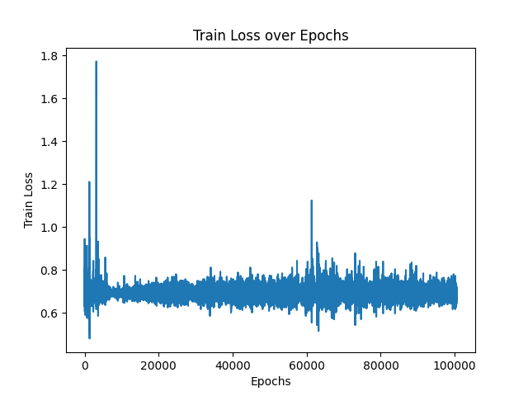
The Reward Function
I used Anthropic’s HH dataset (Helpfulness, Honest, Harmlessness) to train a reward function. The data they provided was of form:
(question, chosen_response, rejected_response)
Here is the loss curve from my training:

Slide 7
Supervised Fine Tuning
SFT is an important part of the RLHF pipeline. It teaches models:
-How to perform tasks
-How to chat back and forth
-How to know when to stop talking
We need data of form: (input, desired_output)
We then use cross-entropy loss on a per-token basis on the model’s response versus the desired_output.

Slide 8
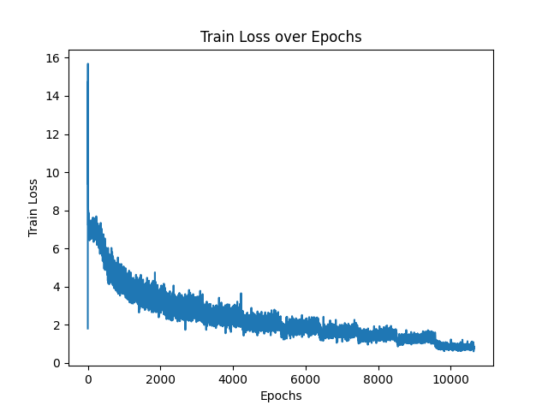
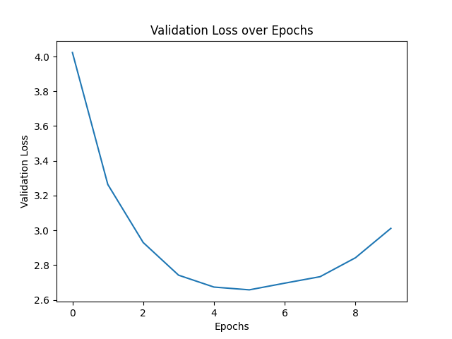
SFT Training
I used two datasets:
OpenThoughts 114k (a dataset of 114,000 question-answer pairs)
Bespoke-Stratos-17k (a dataset of 17k question-answer pairs
Training:

Slide 9
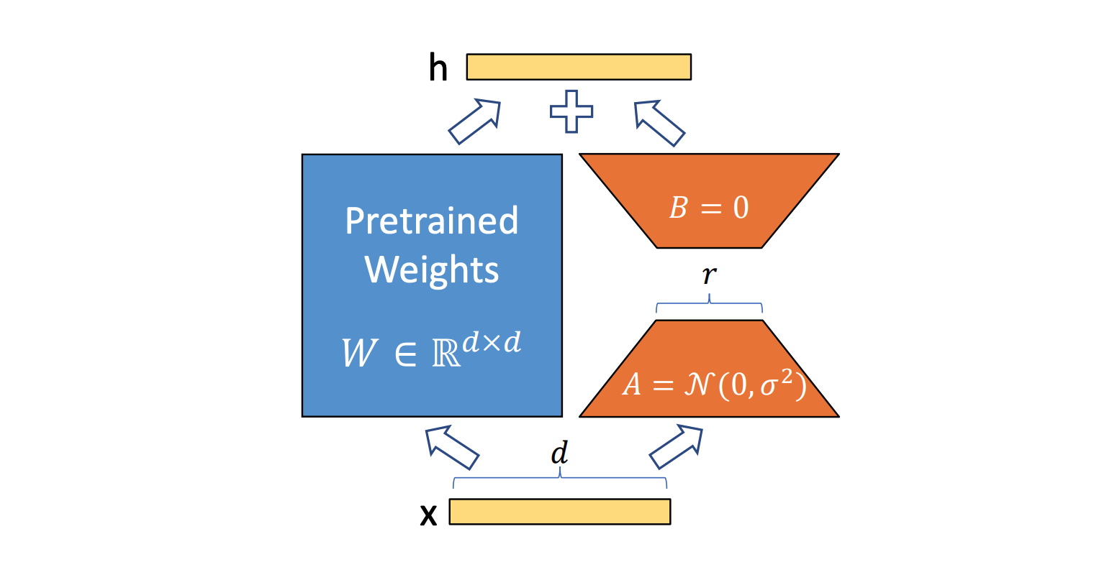
Parameter Efficient Fine-Tuning (PEFT) - LoRA
Full SFT is quite expensive because it updates all the parameters of the model.
We instead freeze all the weights of the model, and inject learnable weight matrices that we add to the frozen weight layers of the matrix. The weight matrices we add are low rank, so are inexpensive.

Slide 10
LoRA Training
I used the safe dataset as in SFT:
OpenThoughts 114k (a dataset of 114,000 question-answer pairs)
Bespoke-Stratos-17k (a dataset of 17k question-answer pairs
Percentage of overall parameters:
Overall Model: 495,114,112
LoRA parameters: 1,081,344
Percentage: 0.2184%

Slide 11
REINFORCE
The REINFORCE Algorithm is a simple algorithm that has been adapted with success in the LLM world, beginning with a paper in Feb 2024: Back to Basics: Revisiting REINFORCE Style Optimization for Learning from Human Feedback in LLMs.
It argues that the simplicity of REINFORCE works well for LLM’s because the RL environment with LLMs is vastly different than the traditional RL landscape:
LLM’s come with significant pretraining, unlike most starting points of RL models
“We note that these findings were based on scenarios with poor conditioning when training from random or weak initialization as opposed to warm-starting it from a strong pre-trained model.”

Slide 12



REINFORCE
The RL function we want to maximize is:
REINFORCE approximates the gradient update as:
For LLM’s, this means scaling the sum of the log probabilities of the model response by the reward!

Slide 13


